Slide 1
http://www.vidyanidhi.com/
ketkiacharya.net@gmail.com
Ketki Acharya
From: SM VITA ATC of CDAC
9769201036
Ketkiacharya.net@gmail.com

Slide 2
Properties
Property is used to Modify the private variable of Class from out side.
using System;
namespace propert_constructor.cs
{
class Employee
{
double _salary;
int empno;
//no () after Salary
public double Salary
{
get {
Console.WriteLine("I am in get");
return _salary;
}
set { //20000
_salary=value;
Console.WriteLine("I am in set"+value);
}
}
}
If instance member are private you initialize data with public constructor. Now think while creating object you entered wrong salary, or you created object with default value. Now how you will rectify or add . your data, as private member is not accessible out side class. Constructor get called only one time when you create object.
To modify existing object we need public setter property.
emp.Salary = 20000;
To read existing object we need public getter property
Console.WriteLine(emp.Salary);.
It is similar to getter setter method in case of java.
You can also write some validation code in set.
public class demo
{
public static void Main()
{
//calling no args constructor given by .NetFrame work
Employee emp = new Employee();
//setter is called
emp.Salary = 20000;
//getter is called
Console.WriteLine(emp.Salary);
}
}
}

Slide 3
Employee emp = new Employee();
//setter is called
emp.Salary = 20000
When you write above line control will go to this code
set { //20000
_salary=value;
Console.WriteLine("I am in set“+value);
}
Value is key word will hold now 20000
//getter is called
Console.WriteLine(emp.Salary);
When you write above code control will go to setter
get {
Console.WriteLine("I am in get");
return _salary;
}
Why getter setter? Its easy to make instance member public.
To achieve concept of data hiding we make instance member private and using public getter setter we allow user to modify existing object.
void set_Salary()
emp
_salary=0 20000
empno=0
double get_Salary()
20000
If you open ildasm you will see that getter setter is nothing but public methods only.
If class has 20 private instance member do I have to write 20 getter setter?
Yes.
Don’t worry in frame work you have auto implement property which will reduce some code

Slide 4
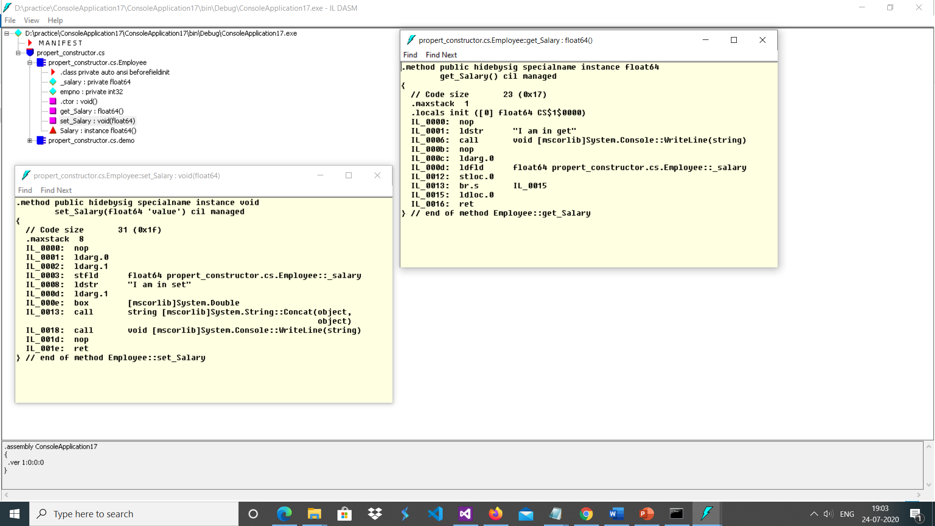
You can observe above float 64 get_salary()
See on left void set_Salary(float64 ‘value’)

Slide 5
User enter name, if name length is <3 it should not allow you to create object
using System;
namespace propert_constructor.cs
{
class Employee
{
string name;
public Employee(string nm)
{
if(nm.Length<3)
Console.WriteLine("minimum length 3 required" );
else
name=nm;
}
//no () after name
public string Name
{
get {
Console.WriteLine("I am in get");
return name;
}
set { //smvita
if(value.Length<3)
Console.WriteLine("minimum length 3 required" );
else
name=value;
Console.WriteLine("I am in set"+value);
}
}
}
See the code in red colour indicating repetition of code. See the next example how we can avoid this.
In this example
Employee emp = new Employee("vi");
After this line object get created with null due to logic what we have written.
But if you want to ensure that it should not create object at all.
After if condition we have to write
Throw new Exception(“error min length 3 required”)
This line will throw exception and program gets terminate
public class demo
{
public static void Main()
{
Employee emp = new Employee("vi");
Console.WriteLine(emp.Name);
//setter is called
emp.Name= "vita";
//getter is called
Console.WriteLine(emp.Name);
}
}
}

Slide 6
Lets use some validation
using System;
namespace _05prop_const{
class propdisp {
string _name;
public propdisp(string nm)
{ Name = nm;
Console.WriteLine(_name);
}
public string Name
{
get{
Console.WriteLine("get called");
return _name;
}
set{
Console.WriteLine("set called");
if (value.Length <3)
Console.WriteLine("err");
else
_name = value;
}
}
}
class Program {
static void Main(string[] args)
{ propdisp obj = new propdisp("vi");
} }
}
In previous example we want to set validation. Minimum length of name has to be 3letter. Now where should I write validation ?
In constructor, and then again in setter.
Repetition of code is not a good practice
In this example we are writing validation code in setter..
In constructor we are calling setter so if data is valid value is set
Otherwise it will display error message, and null value is set.
Ie object get created
How can I stop creating object if value is invalid?
You have to throw exception like
throw new Exception(“invalid data”)
(write this line in if condition)
In that case it will not create object at all and code will terminate.
But I do not want code to terminate , fine you already know about exception handling so handle it and try to code on your own we will study exception in next week.
Next demo is using exception which we have not yet done topic just for reference

Slide 7
Throw exception if data is in valid-handle it
using System;
namespace _05prop_const
{
class propdisp
{
string _name;
public propdisp(string nm)
{
Name = nm;
}
public string Name
{
get
{
Console.WriteLine("get called");
return _name;
}
set
{
Console.WriteLine("set called");
if (value.Length < 3)
throw new Exception("name length is < 3");
else
_name = value;
}
}
}
class Program
{
static void Main(string[] args)
{
try
{
propdisp obj = new propdisp("vi");
Console.WriteLine("not"+obj.Name);
}
catch {
Console.WriteLine("cold not created object");
}
propdisp obj2 = new propdisp("vita");
Console.WriteLine("obj,name="+obj2.Name);
}
}
}

Slide 8
Read only property
set { Console.WriteLine("set called");
_name = value;
}
}
public int Id {
get {
return id;
}
}
//observe no setter for Id
}
class Program
{ static void Main(string[] args)
{
propdisp obj = new propdisp("vita");
Console.WriteLine(obj.Name);
Console.WriteLine(obj.Id);
//obj.Id=2 error you can not write
propdisp ob = new propdisp("vidya");
Console.WriteLine(ob.Name);
Console.WriteLine(ob.Id);
}
} }
using System;
namespace _05prop_const
{
class propdisp
{
int id;
static int getid;
string _name;
public propdisp(string nm)
{
Name = nm;
id = ++getid;
}
public string Name
{
get
{
Console.WriteLine("get called");
return _name;
}
If you write only getter then it will become readonly property.
When you need readonly property?
eg,. You can read your PRN number but you can not set it, employee Id is given by company, bank account number is given by bank, Adharcard number so these are readonly property.

Slide 9
Write only property
using System;
class propertyexample
{ int _height=20;
int _width;
public int Height
{ get {return _height;}
}
public int Width
{
set{
if(value<=0)
Console.WriteLine("-ve and 0 not allowed");
else
_width=value;
}
}
public int area()
{ int a;
a=_height*_width;
return a;
}
}
class entryclass
{
static void Main()
{
propertyexample obj= new propertyexample();
Console.WriteLine(obj.Height);
Console.WriteLine("enter widtht");
obj.Width=int.Parse(Console.ReadLine());
int ans=obj.area();
Console.Write(ans);
//Console.Write(obj.Width);error no getter for Width
Console.ReadLine();
}
}
In very few case we use write only property.
Eg.
write-only property could be used to set a password on a User object. Since passwords are usually stored in hashed form, there is (and should be) no way to retrieve a password after it has been set.

Slide 10
Auto implement property
using System;
namespace property_autoimpli
{
class propautoimpli
{
public propautoimpli(string name)
{ Name = name;
Console.WriteLine(Name);
}
public string Name
{ get;
set;
}
}
class Program
{
static void Main(string[] args)
{
propautoimpli obj = new propautoimpli("vita");
}
}
}
Think about it. I have 10 instance member in a class, which does not require any validation. So programmer has to write 10 private member and then 10 getter setter property. Again private member you can not use outside class. Private member initialised through setter and read through getter.
In such situation frame work has come up with auto implement property.
See the code here, where is private variable is it there? Yes open ildasm and check. It has used data hiding concept. Observe no code in get set this is auto implement property.
For simplicity we have use only one property

Slide 11
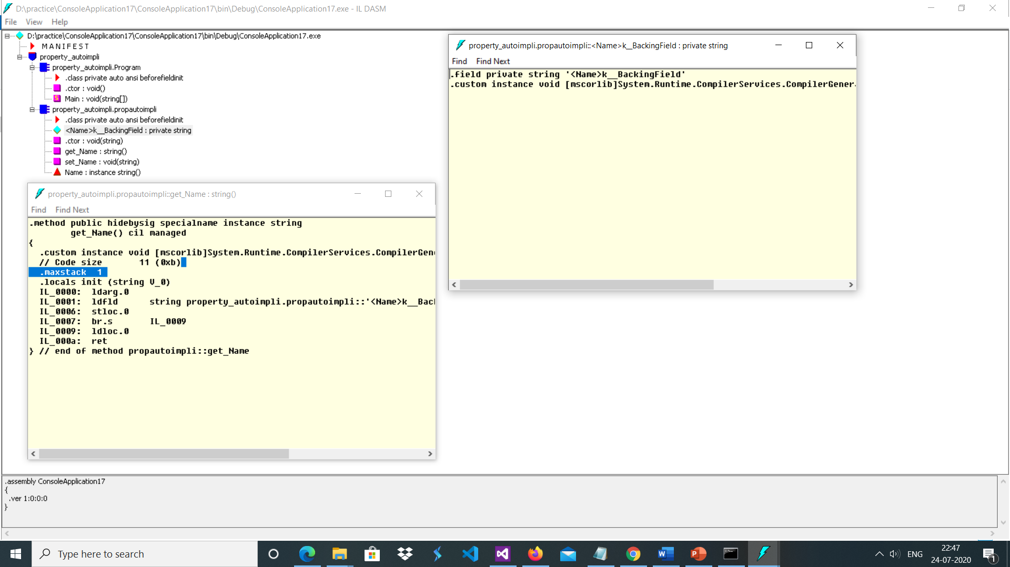
Observe frame work has created private ‘<Name>k_backingField

Slide 12
Rule for auto implement property
You can not have auto implement for readonly property
You can not have auto implement for write only property.
Auto implement is used only for read write property ie get and set both required

Slide 13
Object initializer introduce in version 3.0
// A simple demonstrate that uses object initializers.
using System;
class MyClass {
public double Sal{get; set;}
public string Name{get;set;}
}
class ObjInitDemo {
static void Main() {
// Construct a MyClass object by using object initializers.
MyClass obj = new MyClass { Sal = 1000, Name = "Testing" };
Console.WriteLine(obj.Sal + " " + obj.Name);
}
}
If you do not have any validation we can use
auto implement property and using object initializer
Syntax you can reduce few line of code
See this line
MyClass obj = new MyClass { Sal = 1000, Name = "Testing" };
Here no args constructor get called implicitly and using
{ Sal = 1000, Name = "Testing" };this line is using auto implement setter property

Slide 14
Account application with getter setter and validation. Ie you can not open account with 0 rs.
using System;
namespace basic1
{
class Account
{
static int getid;
int id;
string name;
double balance;
public Account(string nm, double bal)
{
id = ++getid;
Name = nm;
Balance = bal;
}
public string Name
{
get { return name; }
set { name = value; }
}
public double Balance
{
get { return balance; }
set {
if (value < 1)
{ Console.WriteLine("error");
}
balance = value;
}
}
public int Id
{
get { return id; }
}
public void deposit(double amt)
{
Balance += amt;
}
public string Display()
{
return string.Format("{0}{1}", name, balance);
}
}
class AccountDemo
{
static void Main()
{
Account a1 = new Account("Raj", 1000); // create a object
Account a2 = new Account("Geeta", 40000); // create a object
a1.deposit(3000);
a2.deposit(1000);
Console.WriteLine(a1.Display());
Console.WriteLine(a2.Display());
}
}
}
Create Account class having instance member
id,
name ,
balance.
Write getter setter for name and balance. Id is readonly property.
Id should be generated by application.
It has deposit method who’s job is to increase balance.

Slide 15
Create Account class having instance member
1. id- id should be generated by application, it is readonly property
2. name – write getter setter
3. balance- Write getter setter
It has deposit method who’s job is to increase the balance.
Declare static float Interestrate=0.07.
It has withdraw method who’s job is to reduce balance.
Declare conts float minbal=1000. When user withdraw money your application should ensure that minimum balance is maintain.
Give appropriate validation like user can not deposit or withdraw 0 or negative. user can not open account with 0 amount
When you run your application at the beginning it should print name of bank and copy right detail.
It has static method which will calculate and return interest amount for each account holder and increase the balance.
Write display method who’s job is to display Id name and balance and interest received.
If you are comfortable the exception try to use it and handle it also.

Slide 16
public double Balance
{
get { return balance; }
set
{ if (value <= 0)
throw new Exception("negative and zero not allowed");
balance = value;
}
}
public void deposit(double amt)
{
balance += amt;
}
public string display()
{
return string.Format("{0}{1}", name, balance);
}
public static double payint(Account obj)
{
double income = obj.balance * interest_rate;
obj.balance = obj.balance + income;
return income;
}
}
class AccountDemo
{
static void Main()
{
Account a1 = null; ;
try
{
a1 = new Account("Raj", 0); // create a object
Console.WriteLine(Account.payint(a1));//this line will not get executed due to exception
a1.deposit(3000);
}
catch
{
Console.WriteLine("zero value not allowed");
}
Account a2 = new Account("Geeta", 40000); // create a object
a2.deposit(1000);
Console.WriteLine(a2.display());
//create array of Account object
}
}
}
using System;
namespace basic1
{
class Account
{
static int getid;
int id;
string name;
double balance;
static double interest_rate = 0.08;
static Account()
{
Console.WriteLine("Bank of Baroda");
}
public Account(string nm, double bal)
{
id = ++getid;
Name = nm;
Balance = bal;
}
public string Name
{
get { return name; }
set { name = value; }
}
public int Id
{
get { return id; }
}

Slide 17
Assignment
Create a class Employee having private instance member
id- id is readonly property and generated by your application
name- write getter setter
salary- write getter setter
net salary
Write method who’s job is to deduct TDS 10% and return tax amount and set netsalary instance member after deducting tax.
Declare TDS as static variable.
Your application should create only 3 object if you try to create 4th object it should throw exception.
Give appropriate validation like salary can not be 0 or negative, maximum
Salary allowed is 50000 if you try to set more then 50000 it should give some error message.
When you run your application it should print name of company.

